Slide 1
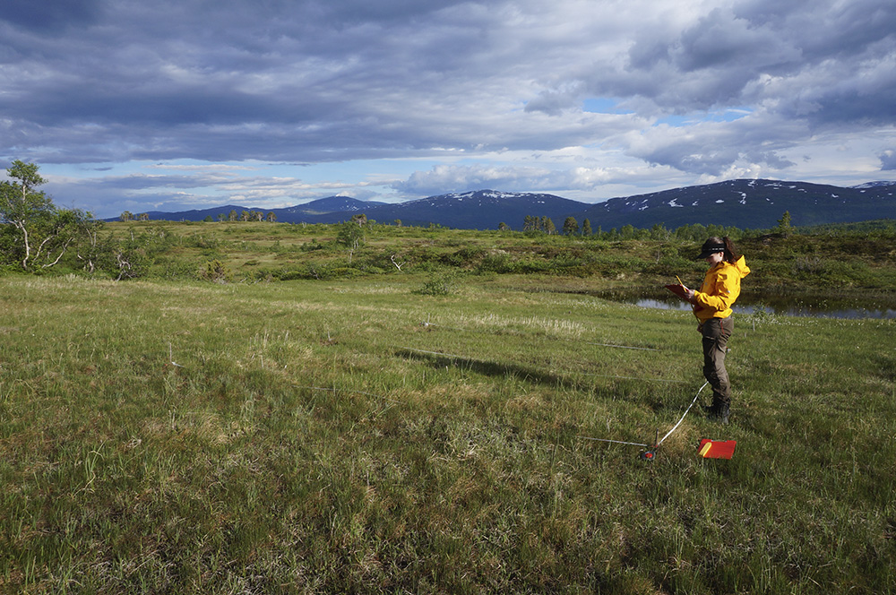
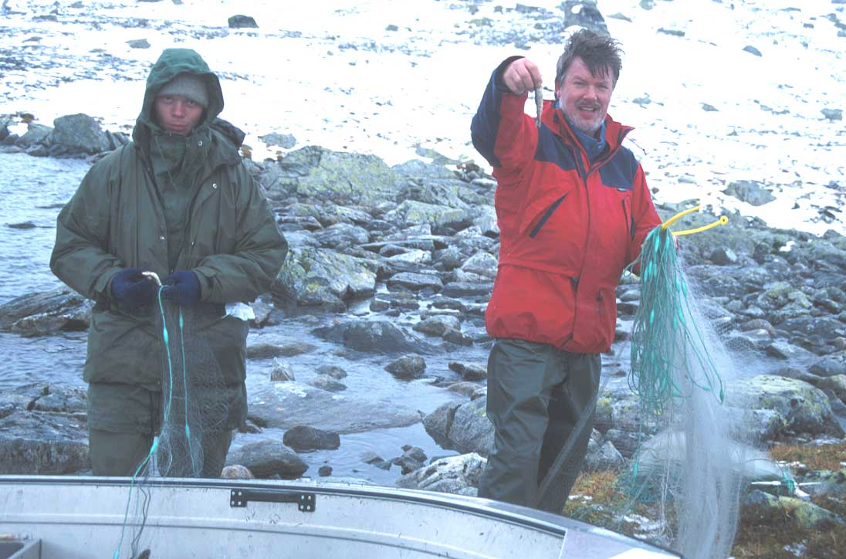
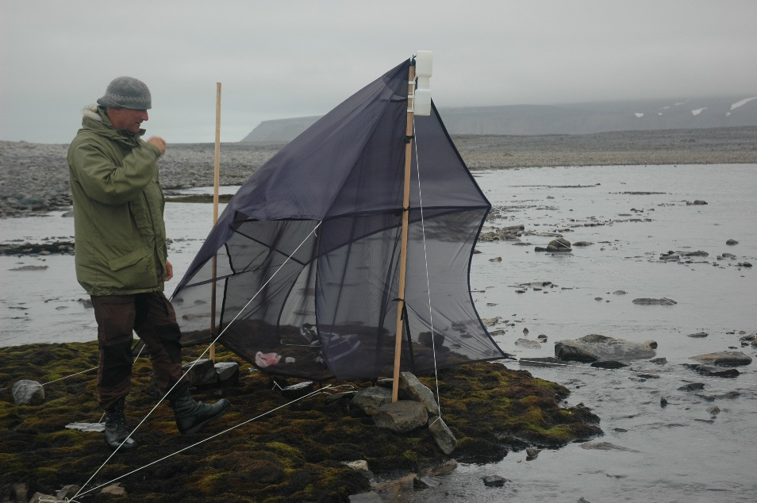
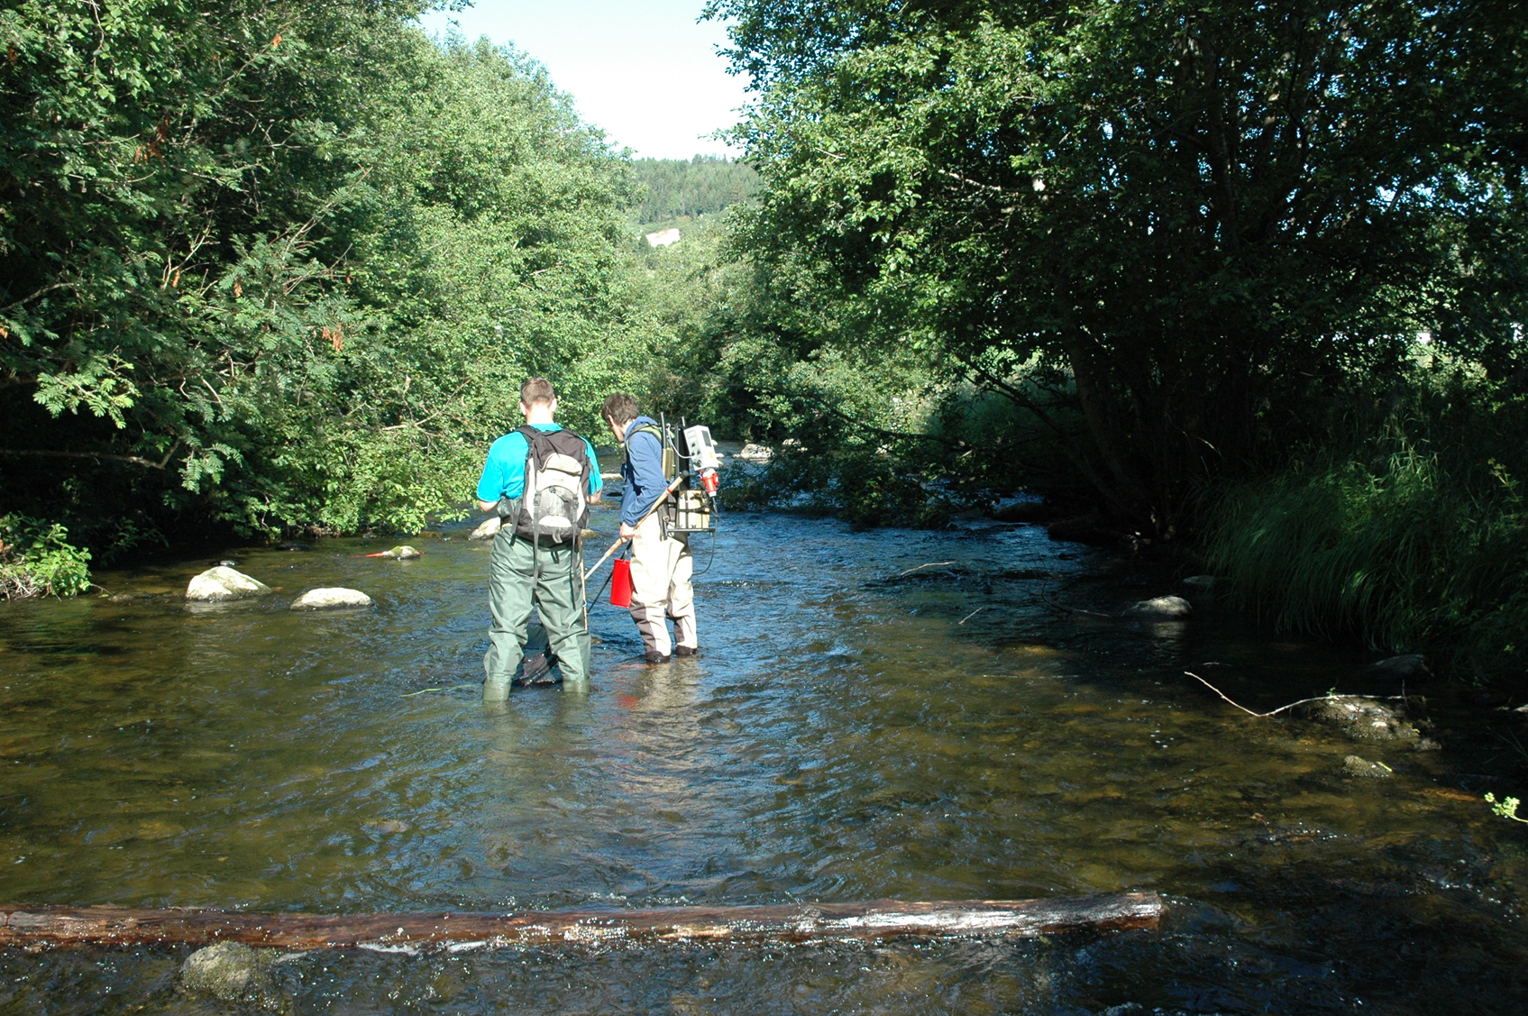
Event data introduction
Marte Fandrem, NTNU-VM CC BY-SA 4.0
Per Harald Olsen, NTNU, CC BY-SA 4.0
Anders G. Finstad, NTNU-VM CC BY-SA 4.0
Anders G. Finstad, NTNU-VM CC BY-SA 4.0

Slide 2
Content
What is “Event-data” / “sample-based data”?
Why does sampling information mather?
How to find event data in GBIF?
The structure of the DwC-A Event-core.
Parsing and data wrangling of Event-core data.
Marte Fandrem, NTNU-VM CC BY-SA 4.0

Slide 3
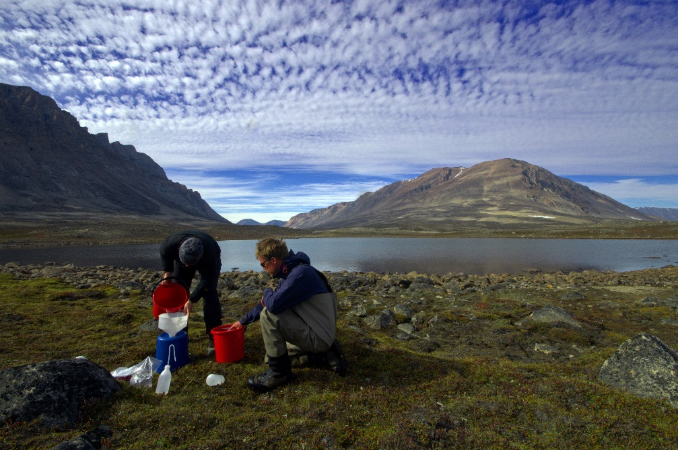
What is event-data / sample-based data?
All biodiversity data are “sampling-based”
Anders G. Finstad, NTNU-VM CC BY-SA 4.0

Slide 4
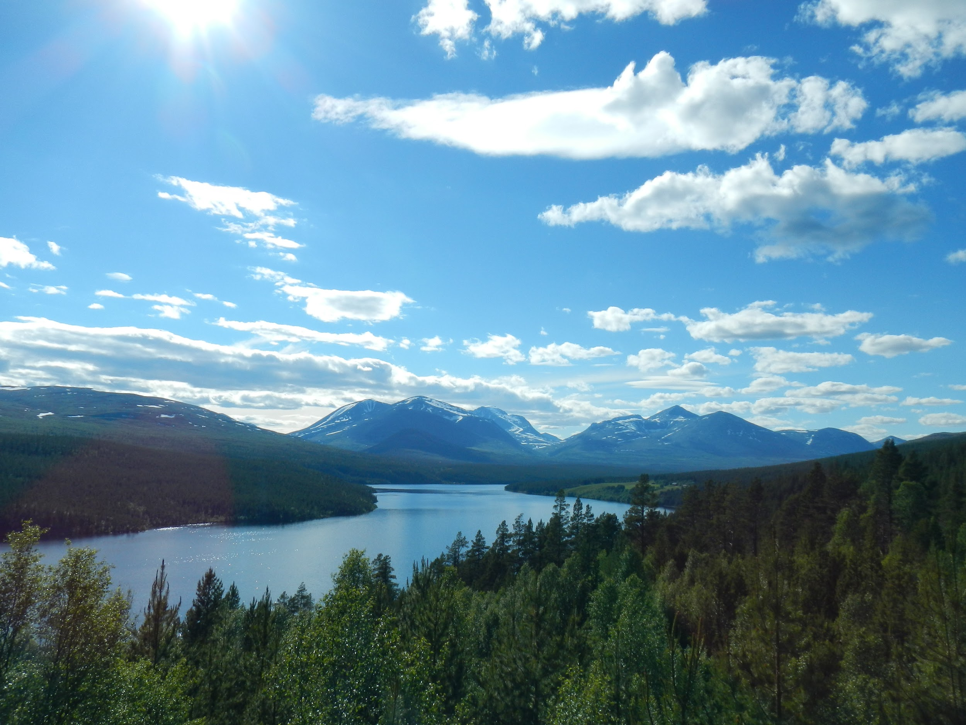

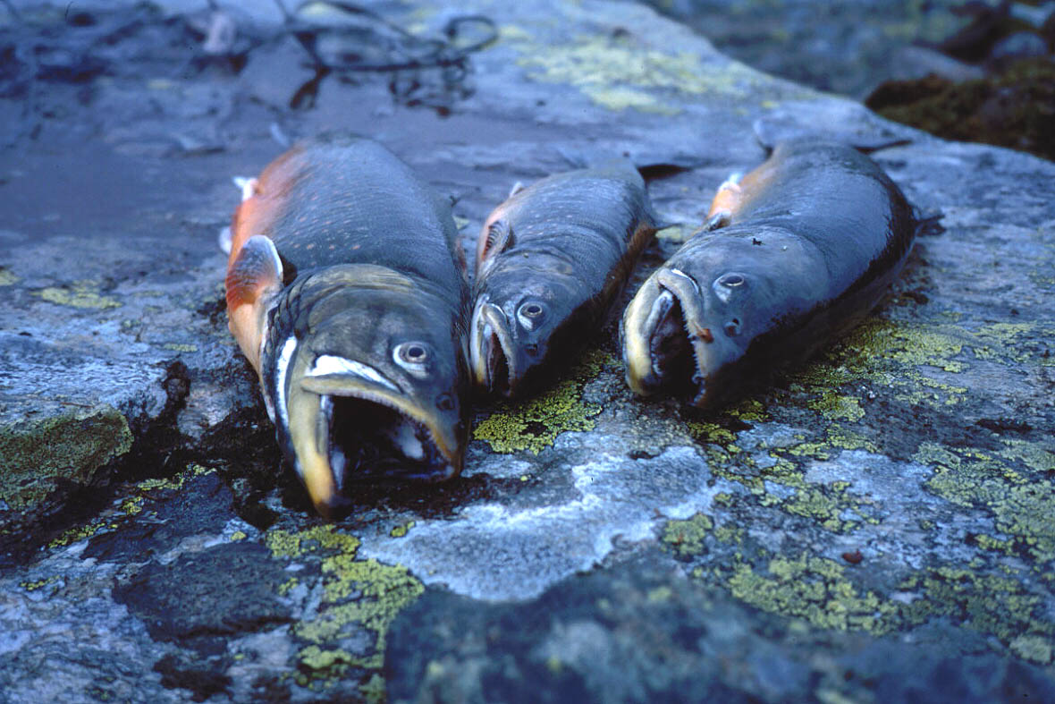
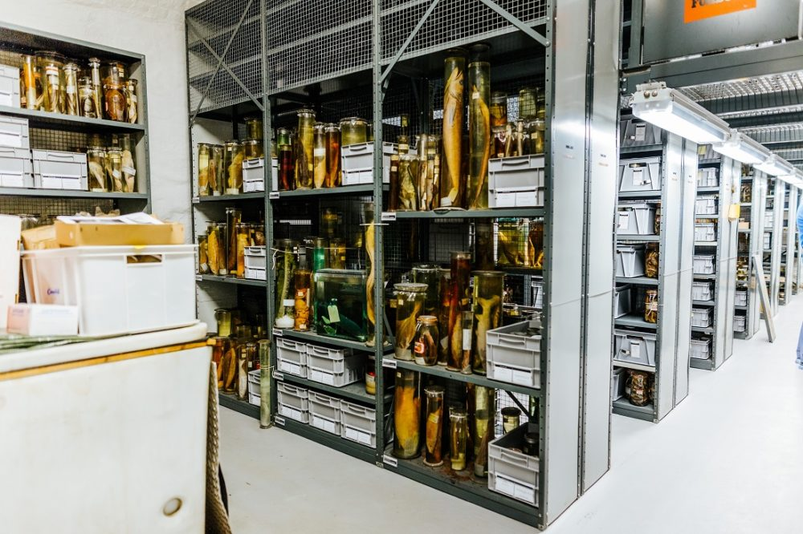

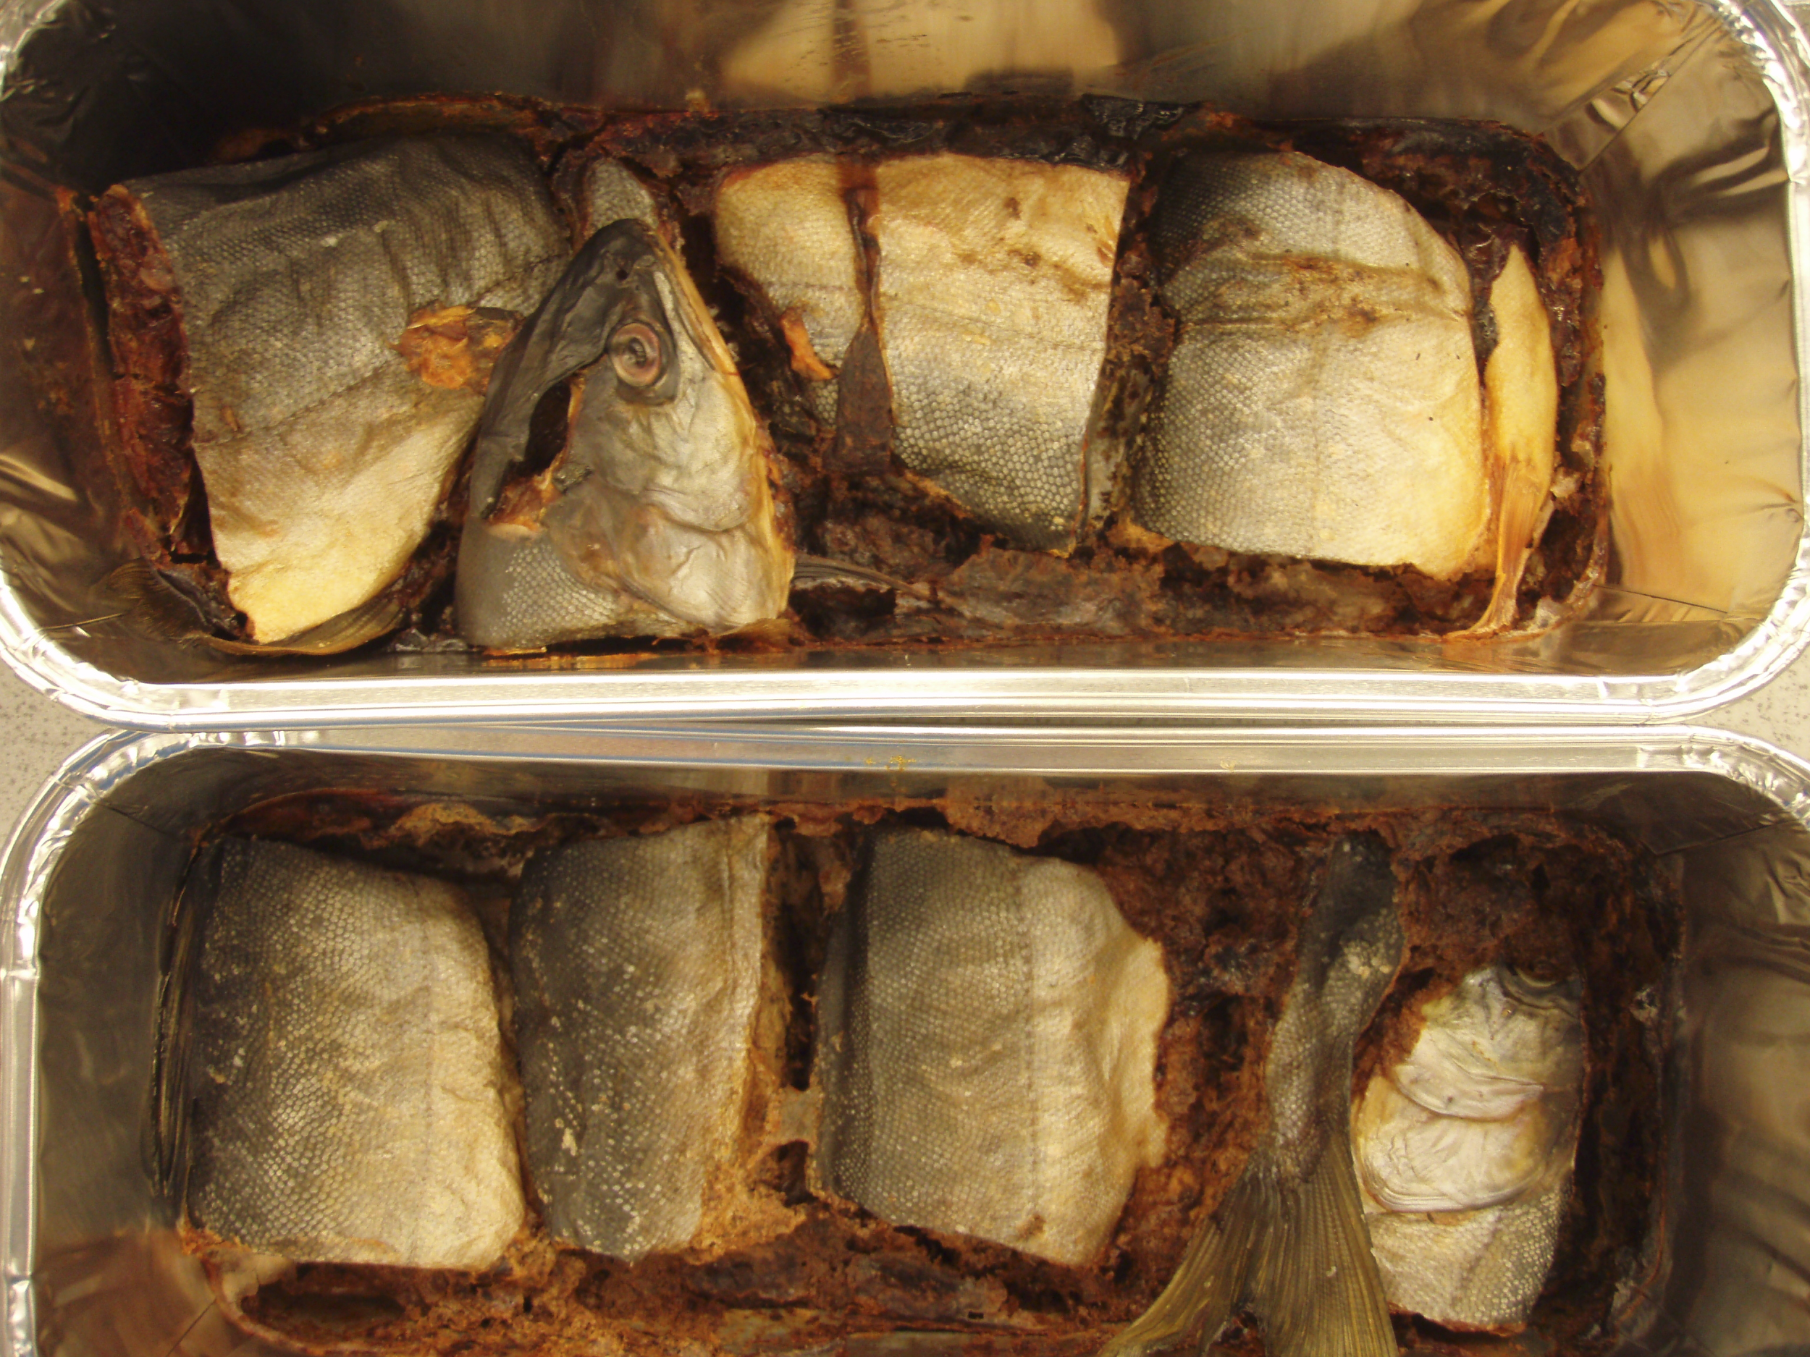
Biodiversity data in a nutshell
Location
Event
Occurrence
MaterialSample
1:n
1:n
n:n
Anders G. Finstad, NTNU-VM CC BY-SA 4.0
Anders G. Finstad, NTNU-VM CC BY-SA 4.0
MeasurementOrFact
MeasurementOrFact
All field-based biodiversity data are sample-based, but only some datasets retain information about the sampling process

Slide 5
Sampling event data (a.k.a. Event data)
Term coined in EUBON and later used in GBIF and the biodiversity informatic community to term datasets that contain presence / absence data or quantitative information (i.e. abundance).
In GBIF, sampling event data points to a specific data-model (the event core Darwin Core Archive).
Presence / absence can (or cannot) be documented on other data-models as well, but not as efficient - i.e. empty sampling events (e.g. traps, gillnets, sites without observations) can not be documented otherwise.
The GBIF API (and hence rgbif) does not return the full depth of sample based data (more of that later).

Slide 6
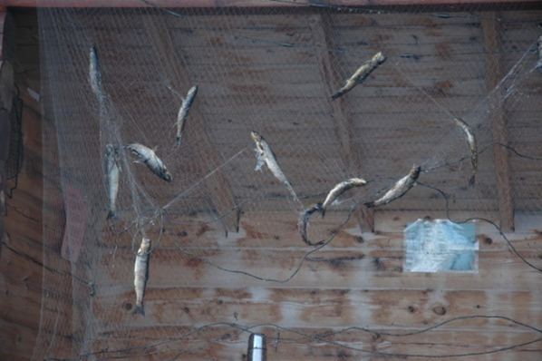
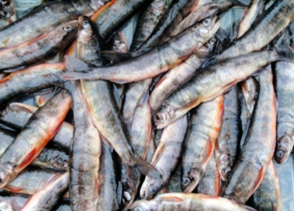
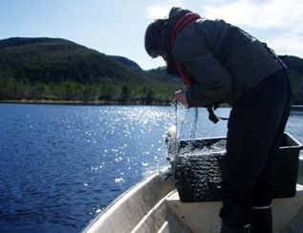
Anders G. Finstad, NTNU-VM CC BY-SA 4.0
organismQuantity and individualCount: Describing some quantity (e.g. mass) and the number of organisms this measure is based upon numbers. occurrenceStatus gives explicit information about absence (not observed) NB! confusion point; what is a quantity and what is a trait?
Anders G. Finstad, NTNU-VM CC BY-SA 4.0
Anders G. Finstad, NTNU-VM CC BY-SA 4.0
samplingProtocol: Describing the sampling gear and it’s usage. Also often needed (not current DwC) is knowledge of taxa intended sampled (taxonomic scope of sampling).
sampleSizeValue and samplingEffort: Describing the sampling intensity and number of replicates
In combination used to estimate measures of population density, indexes of abundance etc.
Sample size (sampleSizeValue+sampleSizeUnit), samplingEffort, organismQuantity (+ organismQuantityType), individualCount and occurenceStatus (present/absent) usually don’t have meaning except in light of the sampling protocol

Slide 7
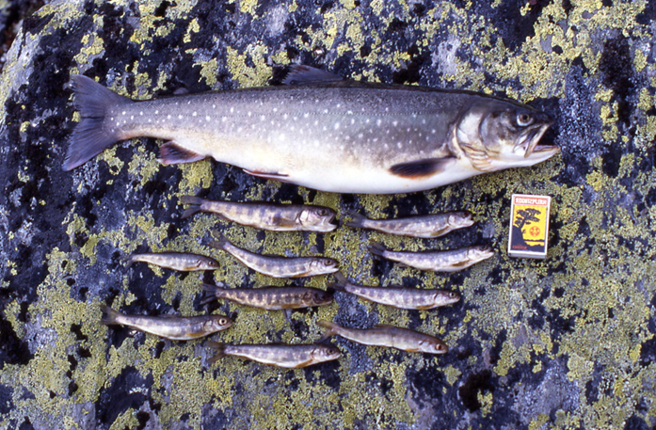
Anders G. Finstad, NTNU-VM CC BY-SA 4.0
Anders G. Finstad, NTNU-VM CC BY-SA 4.0
Anders G. Finstad, NTNU-VM CC BY-SA 4.0
Traits (or quantities – confusion point arising again) of individual or groups of organism occurrences (e.g. age, length, mass, diameter) gives rise to measures of population structure – and summed also abundance measures
samplingProtocol: Describing the sampling gear and it’s usage. Also often needed (not current DwC) is knowledge of taxa intended sampled (taxonomic scope of sampling).
sampleSizeValue and samplingEffort: Describing the sampling intensity and number of replicates
Again, inference of population structure usually meaningless unless information of sampling protocol are given. Different protocols (and gears) are usually highly trait selective.

Slide 8
Why should we care?
Population dynamics (abundance, density measures)
Species distribution and niche modelling
(absence measures / detection probability)
Community-dynamics
(occurrences belonging to the same sample together)
Documenting the sampling process is vital for many applications of data

Slide 9
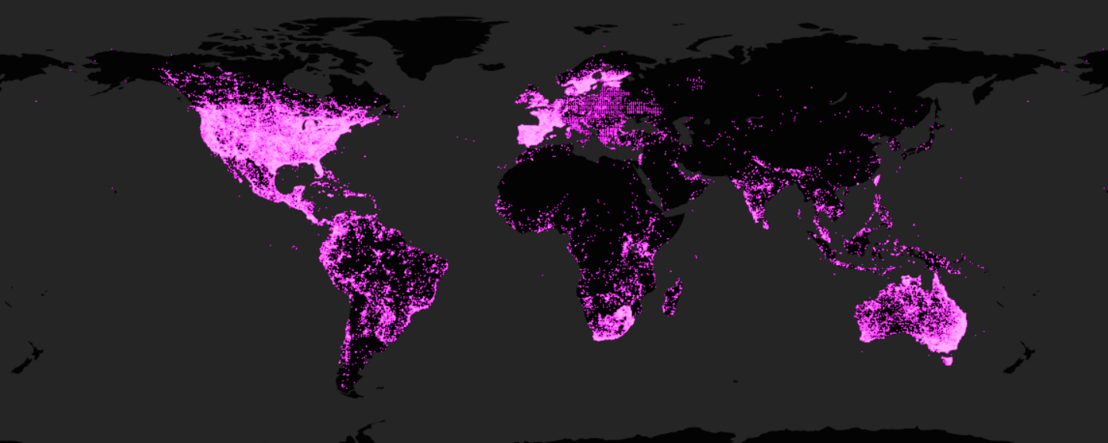
Information on sampling process needed to assess sampling bias

Slide 10
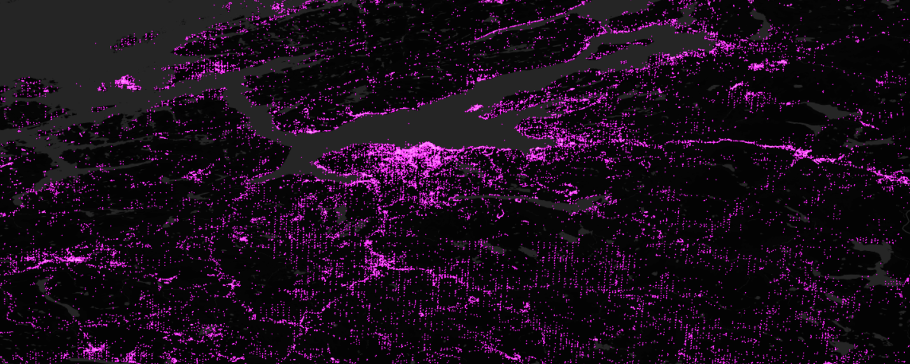
Information on sampling process needed to assess sampling bias

Slide 11
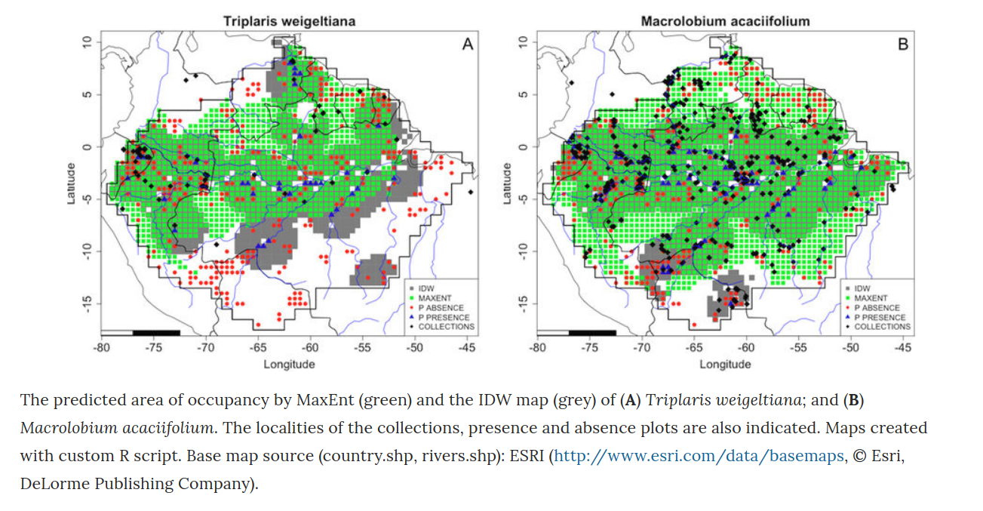
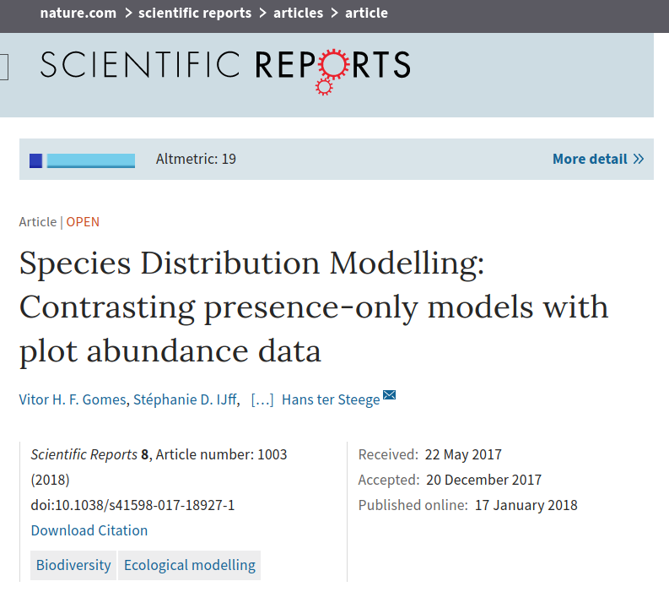
Not accounting for sampling bias may invalid e.g. species distribution models

Slide 12
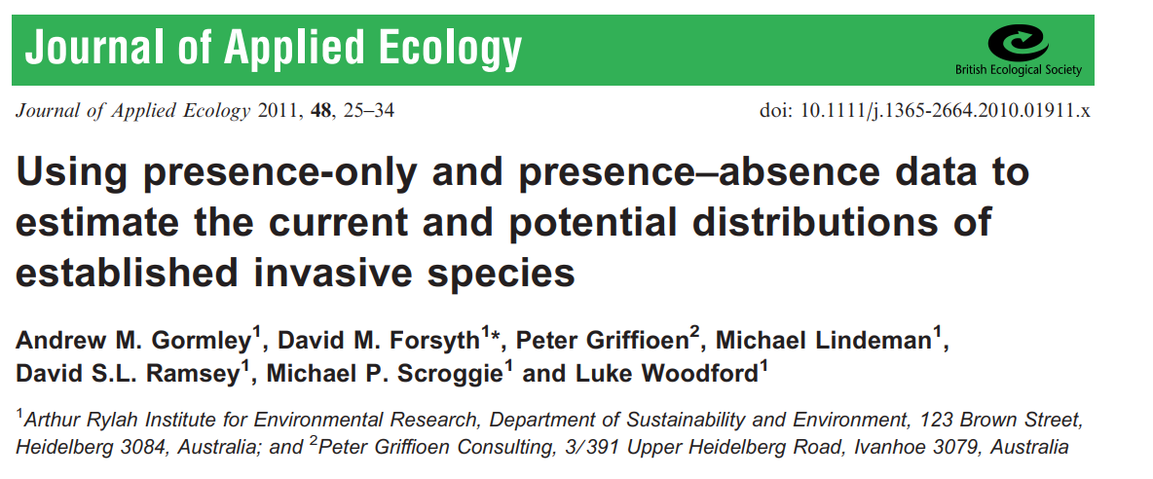
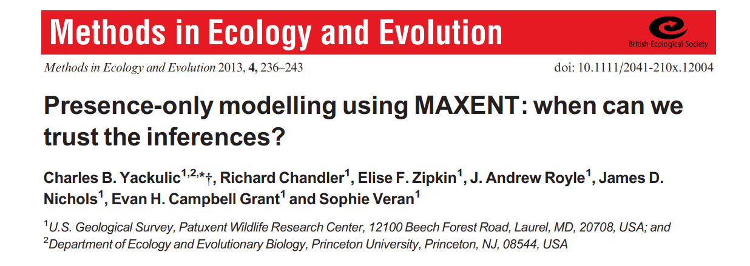
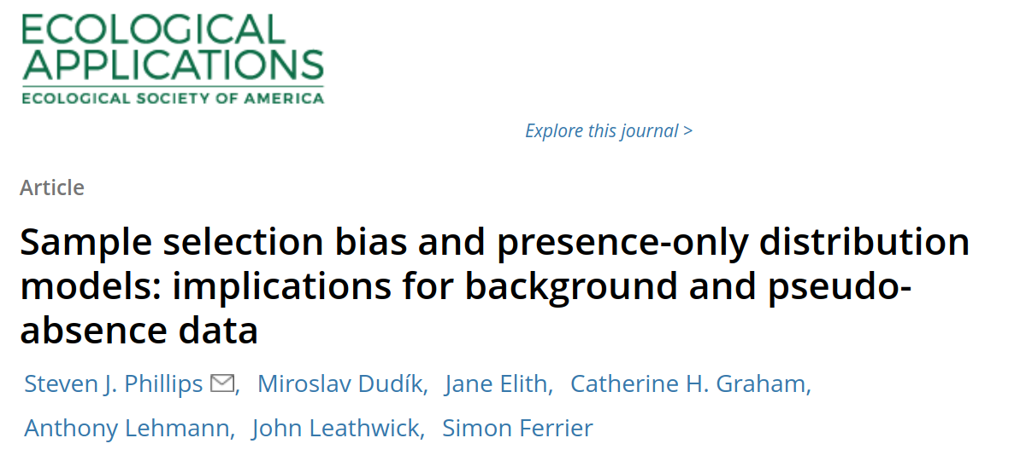
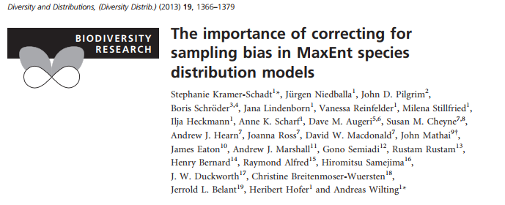
Trouble is: without information on sampling bias you don’t know to what degree inference on presence only is biased
*you may indicate it or assume….
Notes:
(Dag: YES!!! But it is also at least somewhat relevant -- what can you actually do with the data you have…? There certainly exists a more perfect (data-)world, but sampling-based data is still not all that readily available yet. Presence-only data can be used within clear limitations regarding interpretations (see eg scholarly correspondence from Town Peterson and Soberon. Full support for a desired progress towards more sampling-based Event-core based data! But let’s not completely forget that we currently have almost one billion Occurrence data points readily available in GBIF...).

Slide 13
Event data: Technical description
Event term
Identifier: http://rs.tdwg.org/dwc/terms/Event
Type: Class
Definition: An action that occurs at some location during some time.
Examples: A specimen collection process. A machine observation.
Notes:
Dag: Something like this? The Darwin Core technical description…? (Could make it much more technical by reciting the RDF definitions… ;-))

Slide 14
Locations and events “de-normalized” in a DwC-A
eventID | locationID | eventDate |  | samplingProtocol | ….
urn:uuid:e64f0718-f5e9-41fb-9abc-31ac01a2da25 | http://www.geonames.org/11497216 | 2017-04-18 |  | z-sweep
occurrenceID | eventID | scientificName |  | individualCount | sex | …...
urn:uuid:e122e87f-3207-458c-9f21-c5231960c674 | urn:uuid:e64f0718-f5e9-41fb-9abc-31ac01a2da25 | Homo sapiens Linnaeus, 1758 |  | 1 | male
urn:uuid:3026478f-5bdd-439a-abae-8945a5946bb1 | urn:uuid:e64f0718-f5e9-41fb-9abc-31ac01a2da25 | Homo sapiens Linnaeus, 1758 |  | 14 | male
urn:uuid:3026478f-5bdd-439a-abae-8945a5946bb1 | urn:uuid:e64f0718-f5e9-41fb-9abc-31ac01a2da25 | Homo sapiens Linnaeus, 1758 |  | 10 | female
urn:uuid:0b4a7ef9-25fe-478f-b93f-5a0abfed9b00 | urn:uuid:e64f0718-f5e9-41fb-9abc-31ac01a2da25 | Musca domestica Linnaeus, 1758 |  | 108 | unknown

Slide 15
Hierarchical designs
par
“Point-intercept” observation
event
Sampling quadrants
Hierarchically nested parent event(s)
treatments
area
Example: http://www.gbif.org/dataset/418a6571-b6c1-4db0-b90e-8f36bde4c80e

Slide 16
Events linked to a higher hierarchical level using parent-child relationships (recursive data model)
parentEventID | eventID | locationID | eventDate |  | ….
 | urn:uuid:9056477f-5bjk-459a-a26e-8945a5947bb1 | urn:uuid:4a6b5d32-2534-410c-971e-168c209d74b2 | 2017-04-18
urn:uuid:9056477f-5bjk-459a-a26e-8945a5947bb1 | urn:uuid:e64f0718-f5e9-41fb-9abc-31ac01a2da25 | urn:uuid:4a6b5d32-2534-410c-971e-168c209d74b2 | 2017-04-18
urn:uuid:9056477f-5bjk-459a-a26e-8945a5947bb1 | urn:uuid:abca0e51-1528-4a04-969d-cfa5f2734cb2 | urn:uuid:8e8a1c1c-243c-4e13-8b58-cd514c858355 | 2017-04-18

Slide 17
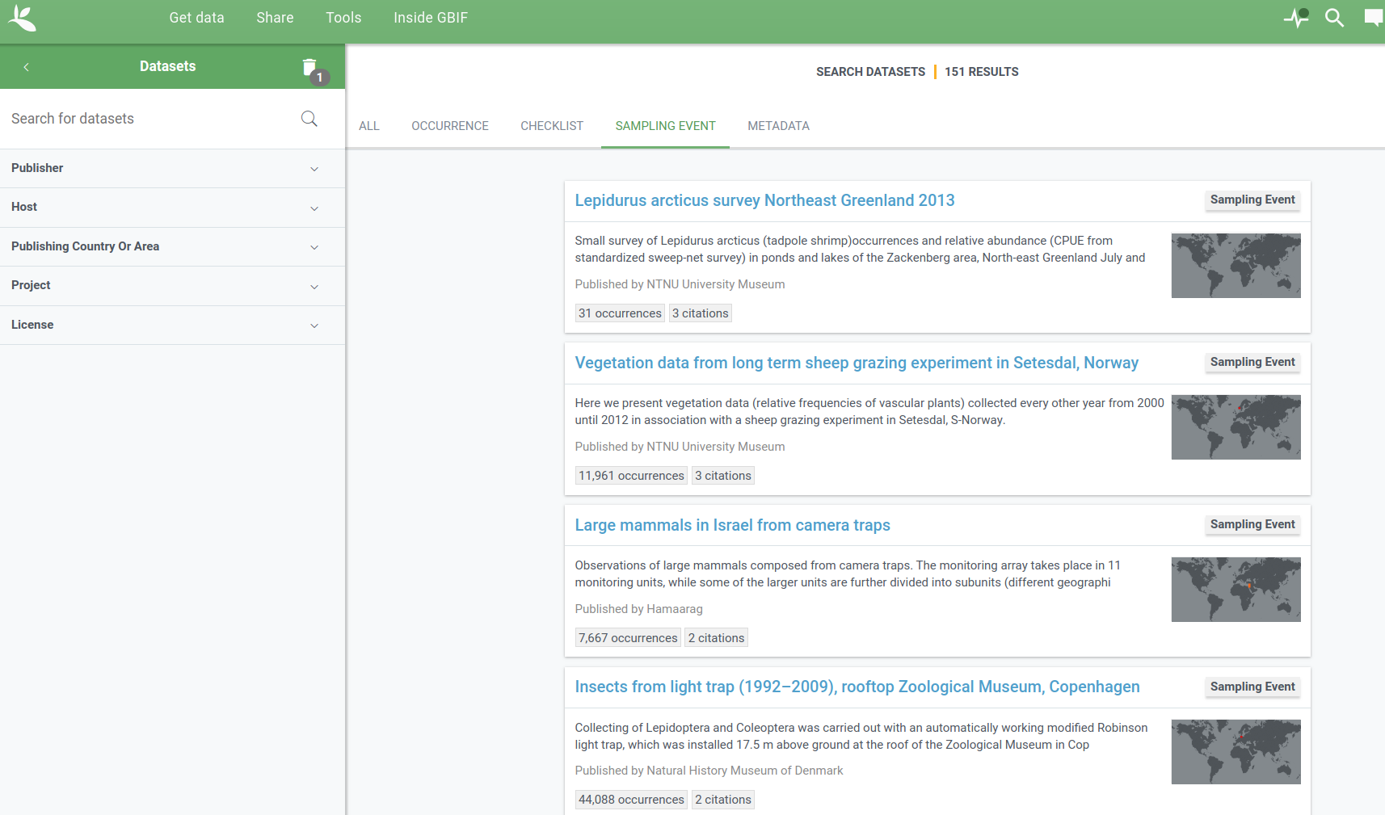
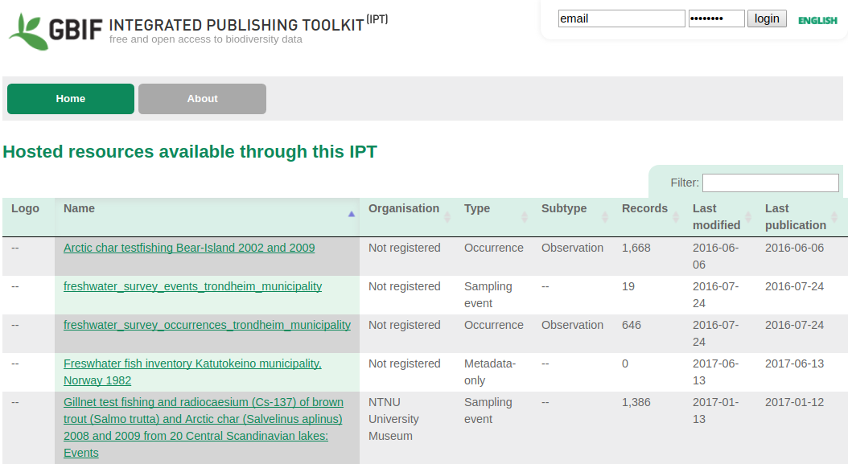
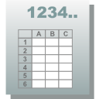
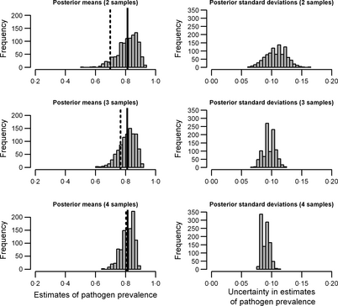

Workflow
Discover data
Find endpoint of DwC-A
Download DwC-A
Occurrences
Event Core
Data-wrangling
Analyse and present

Slide 18
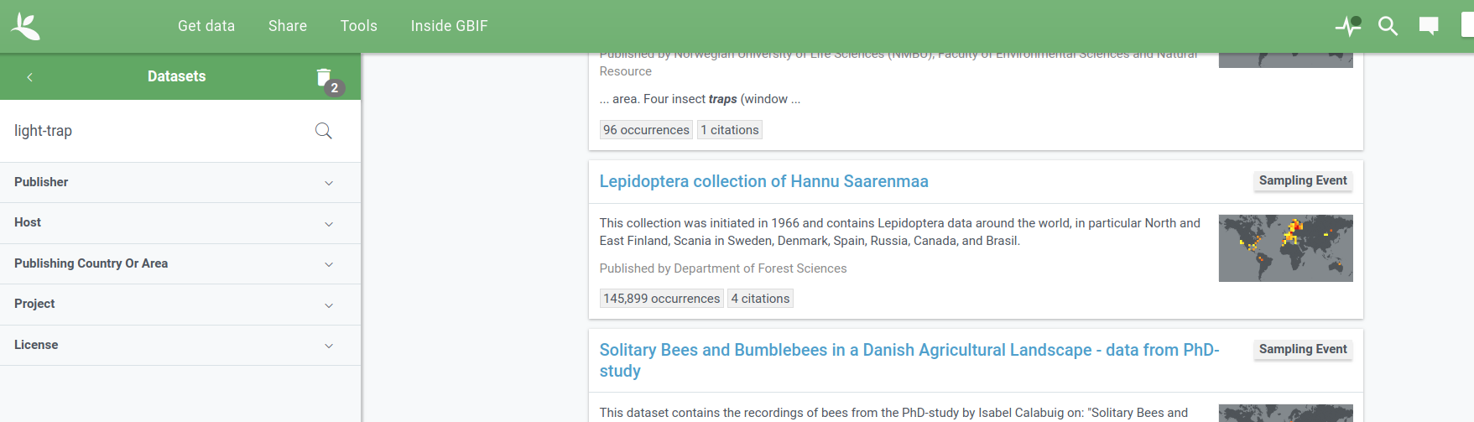
Search metadata
Example: https://www.gbif.org/dataset/search?q=light-trap&type=SAMPLING_EVENT

Slide 19
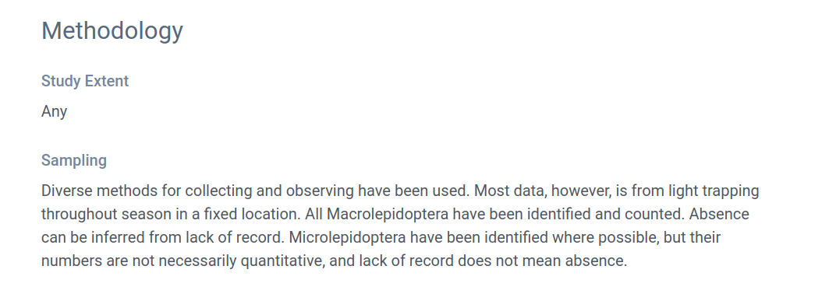
Read metadata
Exsample: https://www.gbif.org/dataset/84ede380-f762-11e1-a439-00145eb45e9a#methodology

Slide 20
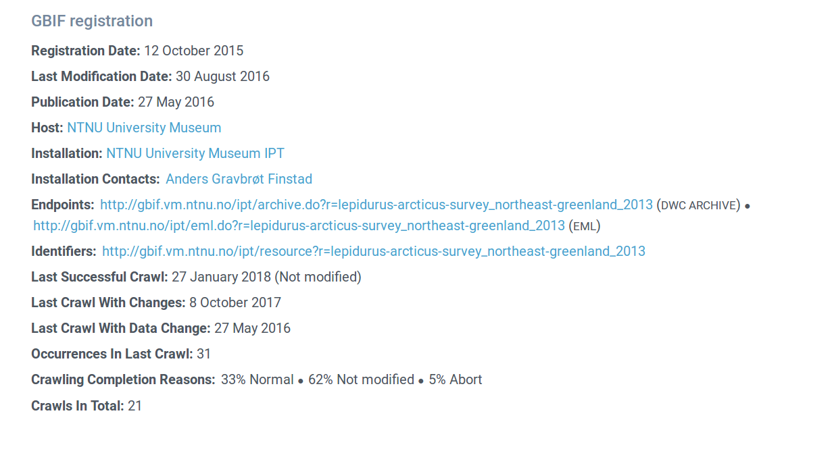
Find download link to DwC archive (data description)
https://www.gbif.org/dataset/78360224-5493-45fd-a9a0-c336557f09c3#dataDescription

Slide 21
Summary
Sampling event type data continuously growing in GBIF, 151 datasets per 2018-02-08.
Data type needed for many applications, either on its own or as method check of other applications.
While access currently not as smooth as for occurrence-only data, data are searchable and downloadable in standardized format. However, reading metadata may be required before use
Programmatic interface creates reproducible workflow and saves time on updates
If your paper is mostly based upon one or a few single datasets, best practice should be to get in touch with data owner (personal opinion)

